Slide 1

University of Pretoria
Division: Tourism Management
Department of Marketing Management
DEMAND AND SUPPLY ANALYSIS FOR DESTINATION DEVELOPMENT:
A Market Analysis Framework
23 March 2018
Berendien Lubbe
Anneli Douglas
Nosi Mahlangu

Slide 2
Rationale for the study
Investment in tourism projects requires:
understanding tourist needs (demand)
how to meet these needs(supply)
Market analysis should be the starting point to inform
product development,
infrastructure development
investment facilitation.
Too many projects lack a rigorous market analysis
when considering the feasibility of a project
in the submissions of the project for funding from both private and public funding bodies
Notes:
To

Slide 3
Overall aim of the study
To develop a market analysis framework that can be used by different tourism stakeholders to inform product development, infrastructure development and investment facilitation with particular reference to the local level.
The framework should address both the supply and demand sides.
Notes:
To

Slide 4
.
The Framework should:
assist entrepreneurs/communities/municipalities etc. to determine the market feasibility of a potential tourism product/project
Provide an understanding of the types of data and information required to assess the market feasibility
provide a framework and guidelines for the funding applicant to effectively structure the information and data on the feasibility of the market in the funding application
provide the funding body with an effective tool for evaluating the funding application in terms of the market potential

Slide 5
Research process
Literature survey
Phase 1:
Current expectations, challenges and gaps in project submissions
Phase2:
Consensus on generic/essential criteria for Market Analysis Framework
Results:
Product - Market
Match Analysis Framework
Information and data sources for populating the Framework
(and existing gaps)
Market analysis
theories,
dimensions criteria, tools,
best case practices,
Semi-structured
in-depth interviews
Delphi Technique

Slide 7
Workbook
Each step in Framework represented in Workbook
Information and data is gathered on each step using
‘diagnostic’ tools (templates)
Includes definitions, objectives and instructions
for each diagnostic tool/template.
Designed to ‘flag’ potential challenges (early on)
which could either lead to:
  Project dismissal
  Adjustments
Allows plotting of each market segment to see if supply
meets demand
SWOT Analysis

Slide 8
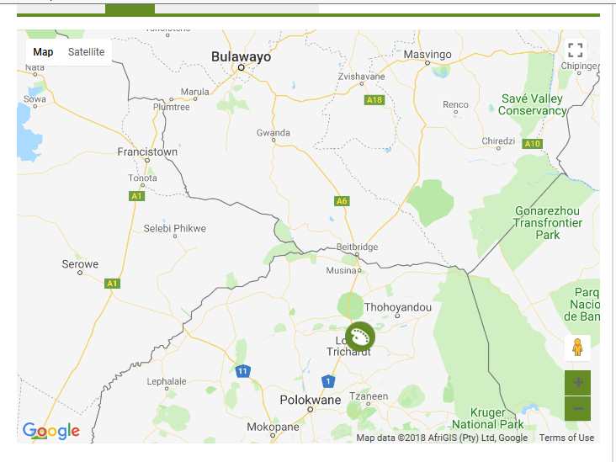
Vha Tsonga Cultural Village
The Cultural Village and Museum aimed at promoting and preserving the cultural heritage of the Valoyi Va–Tsonga people.
Notes:
To

Slide 9
Plotting each market segment

Slide 10
Plotting each market segment
Domestic VFR Ancestral (Back to my roots) Travellers
This market travels regularly to the Province to visit friends and relatives and, if their ancestry is Vha Tsonga, they would want to introduce their children to their ancestral routes and have them experience an authentic representation of the culture and how it was practiced before. They are weekend, long weekend and holiday period travellers and many travel to the area in busses or taxis which may inhibit their accessibility to the Village so transport arrangements from a local point should perhaps form part of a package. This market is very price conscious and low spending. The market would have to be nurtured through awareness creation and comprehensive promotion.

Slide 11
Step 4: SWOT Analysis
STRENGTHS Good location, close to Makhado and en route to KNP, Mapungubwe En route to Zimbabwe No direct competitors Close to tourism generating activities in Makhado and Nature Reserve Close to regional highway | WEAKNESSES Universal accessibility not yet considered Current plan for activities does not include sufficient direct interactivity for tourists with local culture. Very large low spending potential markets Very small high spending potential markets
OPPORTUNITIES Positive global, regional and local economic outlook conducive to tourism growth, both domestic and international Tourist shift to “authentic” experiences Greater regional air access Large untapped domestic VFR market | THREATS Safety and security in the region/crime is too high Flooding issues in rainy season Drought in Cape Town may deter inbound tourists to SA Visa accessibility problematic for some African countries Domestic tourism still quite flat.

Slide 12
Conclusions
Comprehensive work fulfilling a practical need through the Workbook.
Applying the Framework to a case was valuable showing that the diagnostic tools could be applied to a tourism product in a rural setting where information is harder to access.
Study is not a rigid prescription, rather a guideline of what should be thought of when doing a market analysis for a new or existing tourism project.
Each project will have unique considerations.
The Product/Market Match Analysis (Step 3) is directed towards plotting markets on a grid where a quick assessment can be made. However, this analysis requires some thought within the context of each unique project.
Framework can be used by different tourism stakeholders to inform product development, infrastructure development and investment facilitation

Slide 13
THANK YOU

